Slide 1
Branching Model
SVN Branching & Merging
Apresentado por: Robin Ren
Maputo, 20 – Nov - 2018

Slide 2
Agenda
1
What’s a branch?
2
Why is branching so important?
3
How to merge codes?
4
Q & A

Slide 3
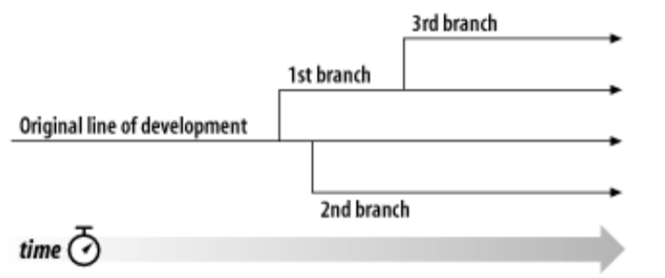
What’s a branch?
1. Basic concept
A line of development that exists independently of another line.
Subversion's branch exists as a normal filesystem directory copied from another directory in the repository.

Slide 4
What’s a branch?
2. Typical repository structure
Side-lines of development created to make experimental or ongoing work without annoying users of the trunk version. Work under a branch stays there until is approved to be merged into the trunk. This is the area where all the work is done.
The tags directory contains snapshots of approved branches and trunk releases.
A main branch recommended by Subversion. The trunk directory contains the most current, approved, and merged body of work. The trunk seems all ready to release, then it is tagged and released.

Slide 5
Why is branching so important?
1. Disadvantages of single line
Inefficient
Once the trunk line is in the middle of test for current release, no more check-ins are allowed therefore developers have to preserve their code changes locally until the trunk is released.

Slide 6
Why is branching so important?
1. Disadvantages of single line
Risky
- The codes on trunk are often un-tested yet.
- Fatal error from one ticket may impact the release of other tickets.

Slide 7
Why is branching so important?
2. New branch for development

Slide 8
Why is branching so important?
3. Advantages of branching
Efficient
Better code quality
Trunk is safer

Slide 9

Why is branching so important?
4. Attention
Do NOT forget to merge codes to trunk if the codes are planned for the release.
Do NOT merge codes to trunk if the codes is out-of-scope for the release.
Make sure to commit “fixes for test/QA issues” to both branches when trunk is being tested.

Slide 10
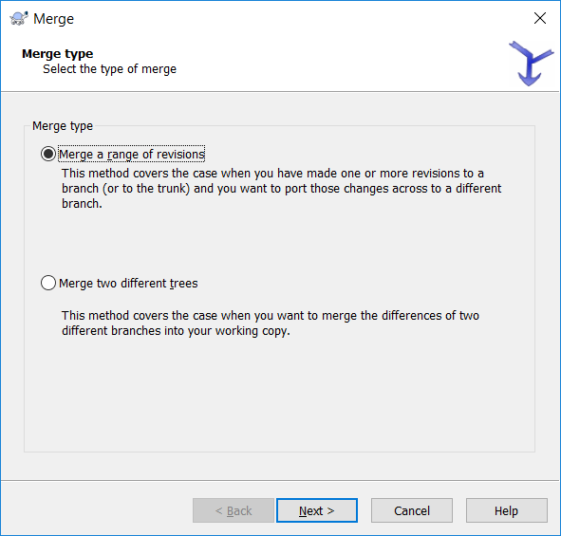
How to merge codes?
1. Merge options
Merge a range of revisions (Cherrypicking)
Merge two different trees

Slide 11
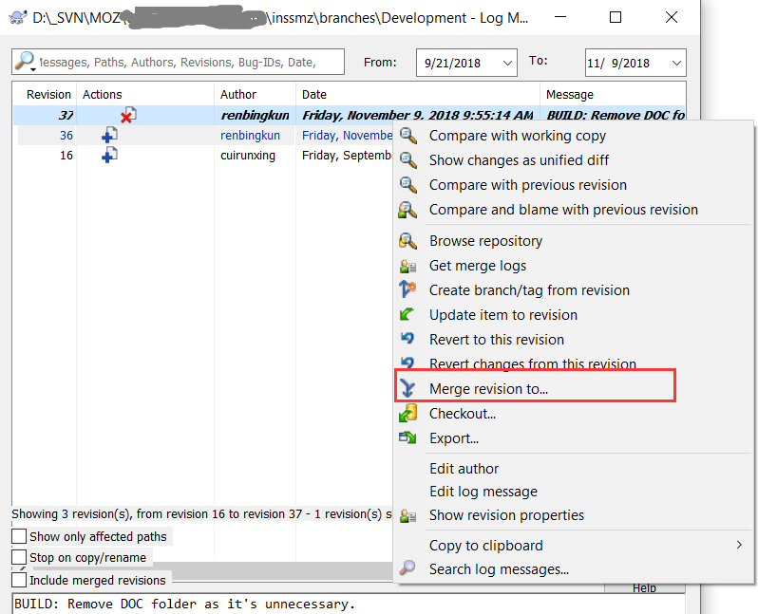
How to merge codes?
2. Merge revision(s) from log

Slide 12
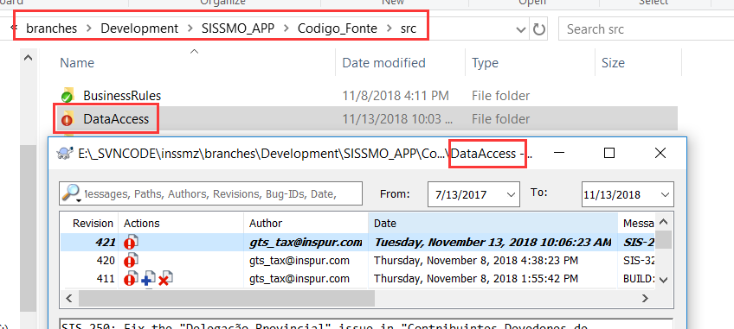
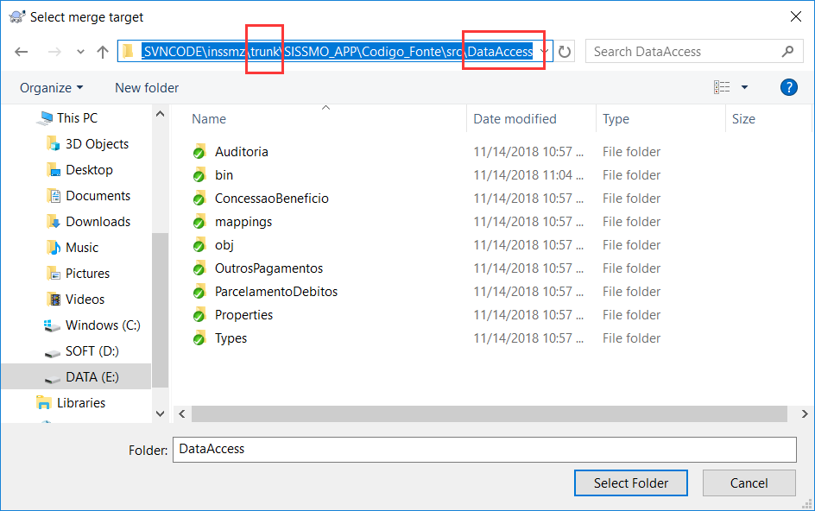
How to merge codes?
2. Merge revision(s) from log
Make sure the target folder is at the same level of code structure as the current folder!
Merge

Slide 13
What to do in our project?
Sync code from “$\inssmz\branches\Development”.
Switch working folder to the new dev branch. Starting from today, all the dev work MUST be done upon dev branch first.

Slide 14
Exercise
Two dump branches “Dev_Dump” and “Trunk_Dump” were already created for practicing under “$\inssmz\branches\”.
You may consider them as our dev branch (“$\inssmz\branches\Development”) and release branch (“$\inssmz\trunk”), respectively.
Practice the following steps:
Update files from one of the dump branches;
Check in the code changes to the branch;
Try merging the code changes to the other dump branch.

Slide 15
Obrigado

